Slide 1
MODULE 4

Slide 2
Introduction to page layout principles and visual frameworks - Basics of page layout, Layout patterns -centerstage, grid of equals, module tabs, accordion, collapsible panels, diagonal balance, and liquid layout. Creation of responsive and flexible page layouts-Usage of containers, rows, and columns to structure content on different devices using Bootstrap 5.

Slide 3
The Basics of Page Layout
Page layout is the art of manipulating the user’s attention on a page to convey meaning, sequence, and points of interaction
several elements of page layout:
visual hierarchy
visual flow
how to use dynamic displays.

Slide 4
Visual Hierarchy: What’s Important? What’s Related?
The concept of visual hierarchy plays a part in all forms of graphic design.
Visual hierarchy is essential for effective design, guiding the reader's attention and conveying the importance of content. The key principles include:
Emphasis on Important Content: The most crucial information should be prominent, using size, color, and placement to draw focus.
Clear Structure: Titles should be distinct from subtitles, and lists should be visually recognizable. This helps readers quickly understand the layout and flow of information.
Ranking Elements: Arrange content in descending order of importance, ensuring that less critical elements are less eye-catching.
Relationships Among Elements: Use spacing and alignment to illustrate how different pieces of information relate to one another.

Slide 5
How to make things look important
For short but large text such as headlines and short phrase use font size, contrasting color, and visual weight
You can also make text look very dramatic by setting it off with generous whitespace or background color.
Use two or more of these characteristics at a time on emphasized text to differentiate it from body text.

Slide 6
Blocks of smaller items such as body text, links, or interactive tools can be emphasized or deemphasized with these tools.
Density--A dense, heavy-looking block has stronger contrast with the surrounding page; an open look has less contrast.
Background color--Contrast draws attention. Black on white, or vice versa, is the strongest contrast possible.
Position and size--A medium or large text block, roughly in the center of the page, calls attention to itself as the primary content (like an article or blog post). But a small strip of text at the bottom of the page says quietly, “I’m just a footer” and begs to be ignored!
Rhythm-- Lists, grids, alternating elements such as headlines and summaries, and whitespace separation can create a strong visual rhythm that irresistibly draws the eye.

Slide 7
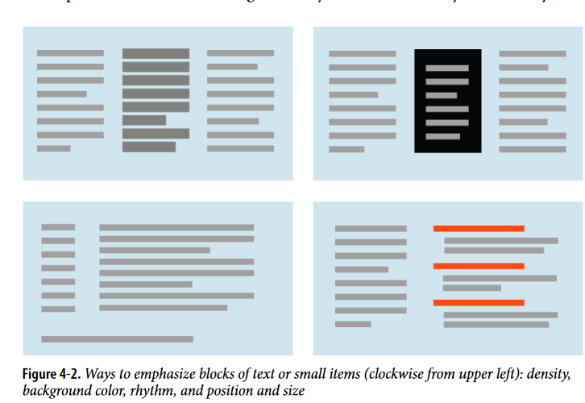

Slide 8
To highlight small but important items on a page, place them at the top, along the left side, or in the top-right corner.
Use high contrast, visual weight, and ample whitespace to make these items stand out. In text-heavy environments, like websites, essential controls such as search fields, sign-in boxes, and large buttons naturally draw attention due to their functionality.
Users often naturally look for these elements, so their placement and prominence are crucial for usability

Slide 9
High-contrast and dramatic images can capture attention, especially pictures of faces, but viewers often overlook images when focused on gathering information or completing tasks.
Images can disrupt visual hierarchy if not used thoughtfully, as they may distract from important content.
Additionally, users may experience "ad blindness," consciously ignoring elements that resemble advertisements, even if they contain valuable information.
This highlights that users actively choose what to focus on, filtering out what they perceive as unnecessary.

Slide 10
How to show relationships among page elements
Grouped items look related . Conversely, isolation implies distinction
To make one item stand out among similar ones, give it a different treatment, like a contrasting background color, while keeping it consistent with the others.
You can also use graphic elements to disrupt alignment, such as bumps or overlaps.
When listing similar items in a strong line or column, ensure they are precisely aligned to create a visual flow.
This helps viewers process the items in a specific order, following Gestalt principles. Examples include bulleted lists, navigation menus, and tables. Using alternating repetition can add visual appeal and rhythm to the layout.

Slide 11
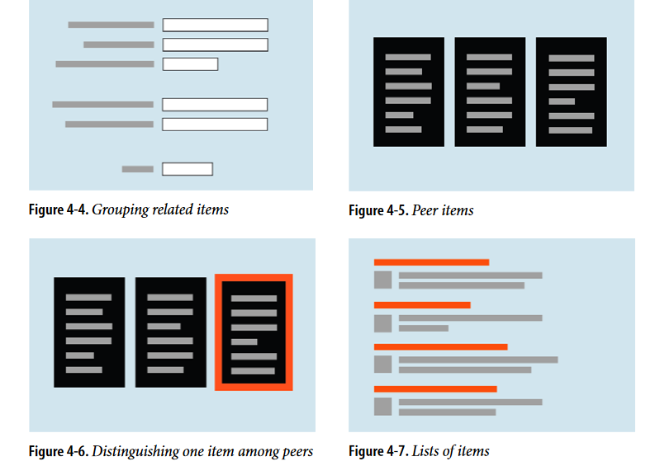

Slide 12
Indented and smaller text beneath a stronger element, like image captions or secondary information, modifies the main element's emphasis.
Containment, using boxes or blocks of color, suggests a parent/child relationship among related items.
This can be achieved with various design elements like Module Tabs or Accordions, utilizing whitespace to clearly nest items.
Indenting also indicates relationships, especially in outlines or hierarchical menus, reinforcing how information is organized.

Slide 13
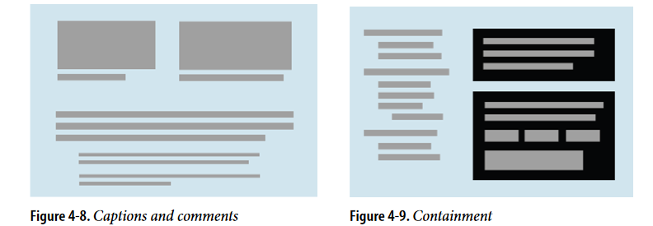

Slide 14
Visual Flow: What Should I Look at Next?
Visual flow refers to the path that readers' eyes follow as they scan a page, closely linked to visual hierarchy.
A well-structured visual hierarchy creates focal points that draw attention to important elements and guides the eye to less critical information in a desired sequence.
Readers typically scan from top to bottom and left to right, but strong focal points can disrupt this natural flow.
Effective design uses a limited number of focal points to maintain their importance, ensuring that viewers are directed to the right places in the right order.
Observing well-designed ads can provide insights into how focal points effectively capture attention.

Slide 15
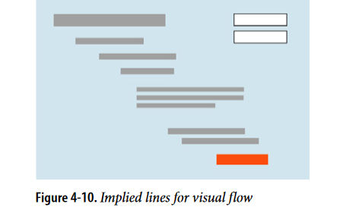
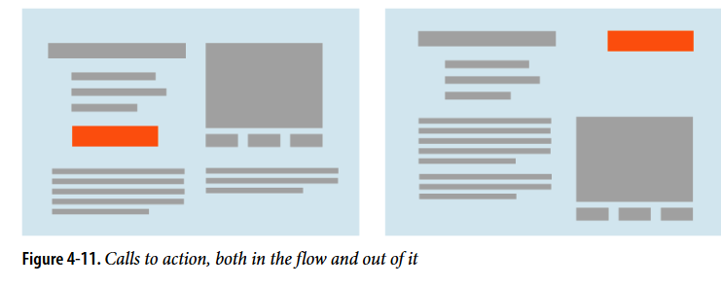
So how do you create a good visual flow?

Slide 16
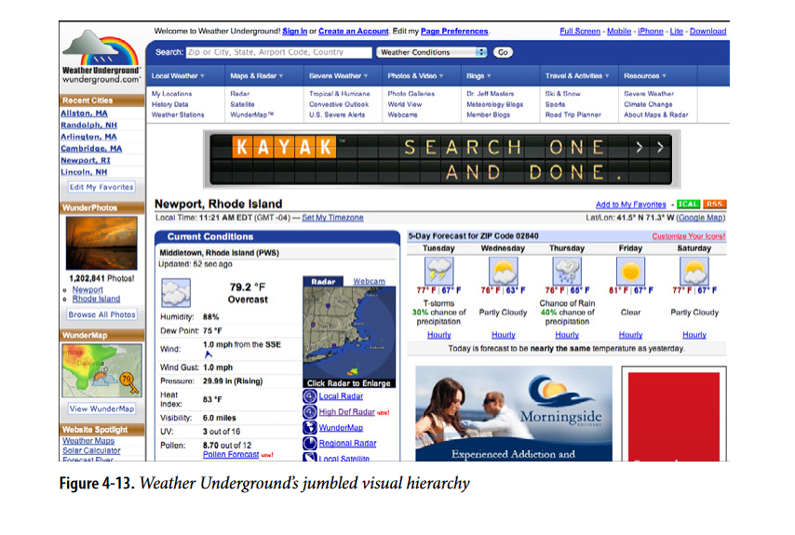

Slide 17
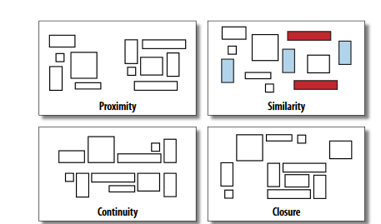

Slide 18
Using Dynamic Displays
Unlike static layouts (posters, magazines), computer displays allow for dynamic interaction over time.
Screens, especially mobile devices, have limited space compared to traditional media, requiring efficient use of that space.
Dynamic Techniques:
Scrollbars: Enable users to navigate through large content areas.
Content Organization:
Module Tabs: Allow users to switch between different content sections.
Accordions: Expand/collapse content to save space.
Collapsible Panels: Provide a clean way to manage content visibility.
Movable Panels: Give users control over their layout.

Slide 19
Using Dynamic Displays
Navigation: Breaking content into virtual pages can enhance user experience by allowing navigation through sections.
Guided User Experience: Techniques like Responsive Enabling and Responsive Disclosure help direct users through a sequence of steps.

Slide 20
The Patterns

Slide 21
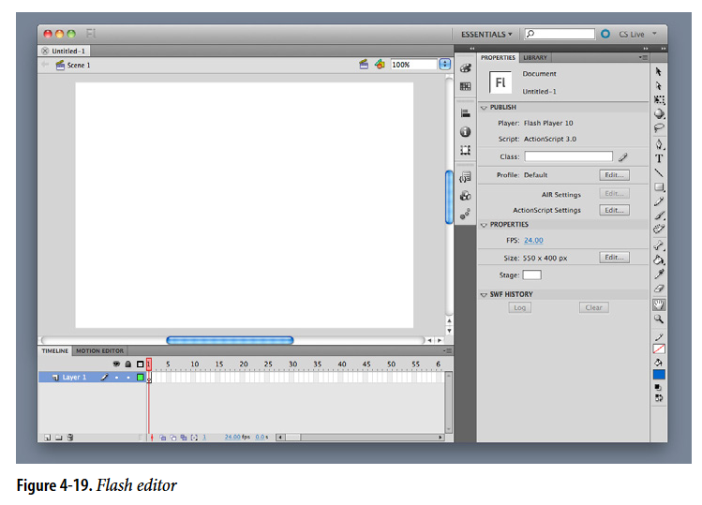
Center Stage
Put the most important part of the UI into the largest subsection of the page or window; cluster secondary tools and content around it in smaller panels.

Slide 22
Center Stage
The page’s primary job is to show a single unit of coherent information to the user, let him edit a document, or enable him to perform a certain task.
Other content and functions are secondary to this one.
Why
The design should guide the user’s eyes immediately to the start of the most important information (or task) rather than have them wandering over the page in confusion

Slide 23
WHY
A clear central entity in a user interface acts as an anchor for the user's attention, much like the lead sentence in a news article sets the stage for the content.
This focal point establishes the UI's purpose, allowing users to easily assess surrounding elements in relation to it.
Instead of scanning the page multiple times to determine the order and relevance of information, users can quickly understand how peripheral items connect to the central theme, enhancing their overall navigation and comprehension.

Slide 24
HOW
Establish a visual hierarchy with the primary content or document dominating everything else
When designing a Center Stage, consider following factors,
Size - The Center Stage content should be at least twice as wide as whatever’s in its side margins, and twice as tall as its top and bottom margins.
Color- Use a color that contrasts with the items in the margins. In desktop UIs, white works well against Windows gray, especially for tables and trees.
As it happens, white often works in web pages too, since ads and navigation bars usually use other colors as their backgrounds; also, web users have been “trained” by convention to look for the plain text on a white background.

Slide 25
Headlines- Big headlines are focal points, and can draw the user’s eye to the top of the Center Stage.
Context- What does the user expect to see when she opens up the page? A graphic editor? A long text article? A map? A filesystem tree? Work with her preconceptions; put that in Center Stage and make it recognizable.

Slide 26
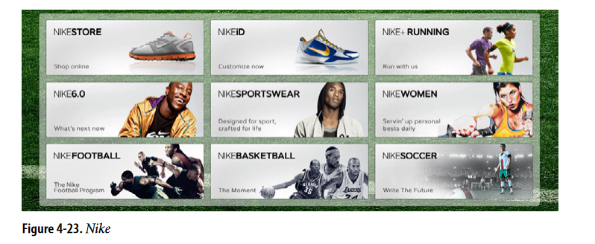
Grid of Equals
Arrange content items in a grid or matrix. Each item should follow a common template, and each item’s visual weight should be similar. Link to jump pages as necessary

Slide 27
The page contains many content items that have similar style and importance, such as news articles, blog posts, products, or subject areas.
You want to present the viewer with rich opportunities to preview and select these items.
WHY
A grid that gives each item equal space announces that they have equal importance.
The common template for items within the grid tells the user that the items are similar to each other.
Together, these techniques establish a powerful visual hierarchy that should match the semantics of your content.
Grids look neat, ordered, and calming. That may suit the style of your site or app.

Slide 28
HOW
Figure out how to lay out each item in the grid.
Do they have thumbnail images or graphics? Headlines, subheads, summary text? Links to jump pages (e.g., a page with the fullstory)?
To create an engaging layout, use colorful headlines for each section—blue for events and green for highlights. Add plenty of whitespace to keep it clean and readable.
Arrange the items in a grid with tall, wide, or square boxes, including images alongside the text.
This way, important details like dates and descriptions are clear and easy to find while making the overall presentation visually appealing.

Slide 29
Arrange items in a grid with two or three items per row, making sure it looks good on narrow screens and mobile devices.
Use hover effects to highlight specific items with color changes, but keep their size and position the same.
This way, the design stays stable while still drawing attention to key elements, ensuring a smooth experience for users.

Slide 30
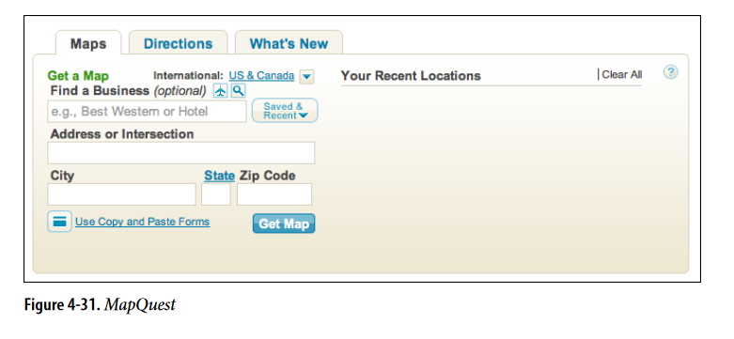
Module Tabs
Put modules of content into a small tabbed area so that only one module is visible at a time. The user clicks on tabs to bring different modules to the top.

Slide 31
Use when
You have a lot of heterogeneous content to show on the page, possibly including text blocks, lists, buttons, form controls, or images. You don’t have room for everything.
Some of the page content comes in groups or modules (or can be sorted into coherent groups).
Those modules have the following characteristics:
Users only need to see one module at a time.
They are of similar length and height.
There aren’t many modules—fewer than 10, and preferably a small handful.
The set of modules is fairly static; new pages won’t be added frequently, nor will existing pages be changed or removed frequently.
The modules’ contents may be related or similar to each other.

Slide 32
WHY
Tabs are common in desktop interfaces and websites, making them easy to understand. They effectively group and hide content, helping to declutter the interface. This way, users can easily switch between different sections without feeling confused

Slide 33
How
First, get the information architecture right. Split up the content into coherent chunks, if it hasn’t already been done for you, and give them short, memorable titles (one or two words, if possible).
If you split up the content incorrectly, users will be forced to switch back and forth between tabs as they compare them or look for information they can’t find.
Indicate the selected tab unambiguously, such as by making it contiguous with the panel itself.

